Slide 1










CTF
CTF
CTF
CTF
CTF
CTF
THE
CLOUD
CLUB
(CAPTURE THE FLAG)
CYPER QUEST
WELCOME ESTEEMED GUESTS, FACULTIES & PARTICIPANTS!

Slide 2

THE
CLOUD
CLUB
WITNESS THE NEXT GENERATION OF CYBERSECURITY EXPERTS
AS THEY TAKE ON
THRILLING CHALLENGES
IN AN ACTION-PACKED EVENT!
🌐 WEB HACKING
🔍 OSINT
🔒 CRYPTOGRAPHY
☁ CLOUD HACKING
🕵‍♂ FORENSIC
🔥 And more!

Slide 3

CTF
CTF
CTF
CTF
CTF
CTF
THE
CLOUD
CLUB
FOLLOW OUR SOCIAL HANDLES
FOR INTERESTING UPDATES!
CYPER CLUB

Slide 4
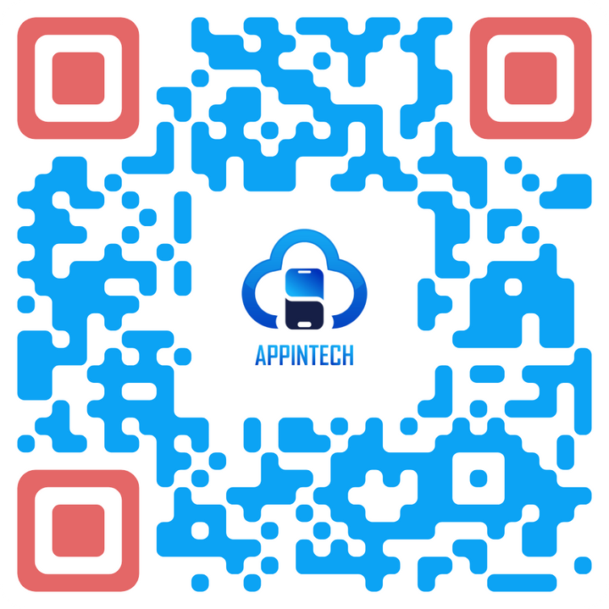
CTF
CTF
CTF
CTF
CTF
CTF
THE
CLOUD
CLUB
FOLLOW OUR SOCIAL HANDLES
FOR INTERESTING UPDATES!
APPINTECH CLUB

